Slide 1
Process Synchronization

Slide 2
Concurrent Processing
The concurrent processing is done by the processes which are cooperative in nature.
They information exchanged between them is done either through shared memory concept of message passing
Concurrent access to shared data may result in data inconsistency.

Slide 3
Producer consumer problem
The Producer-Consumer problem is a classical multi-process synchronization problem, that is we are trying to achieve synchronization between more than one process.
There is one Producer in the producer-consumer problem, Producer is producing some items, whereas there is one Consumer that is consuming the items produced by the Producer. The same memory buffer is shared by both producers and consumers which is of fixed-size.
The task of the Producer is to produce the item, put it into the memory buffer, and again start producing items. Whereas the task of the Consumer is to consume the item from the memory buffer.

Slide 4
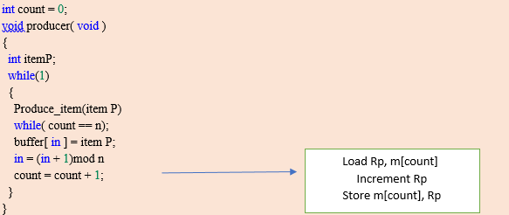
Producer code

Slide 5
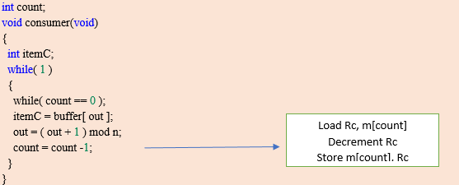
Consumer code

Slide 6
"in" used in a producer code represent the next empty buffer
"out" used in consumer code represent first filled buffer
count keeps the count number of elements in the buffer
count is further divided into 3 lines code represented in the
block in both the producer and consumer code.
If we talk about Producer code first:
--Rp is a register which keeps the value of m[count]
--Rp is incremented (As element has been added to buffer)
--an Incremented value of Rp is stored back to m[count]
Similarly, if we talk about Consumer code next:
--Rc is a register which keeps the value of m[count]

Slide 7
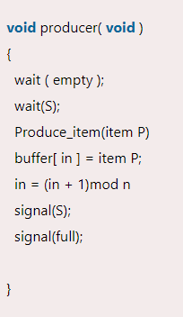
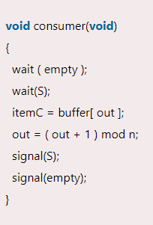
Solution to this problem

Slide 8
"in" used in a producer code represent the next empty buffer "out" used in consumer code represent first filled buffer "empty" is counting semaphore which keeps a score of no. of empty buffer
"full" is counting semaphore which scores of no. of full buffer "S" is a binary semaphore BUFFER

Slide 9
Race Condition
Where several processes access and manipulate the same data concurrently and the outcome of the execution depends on the particular order in which the access takes place, is called a race condition.

Slide 10
The Critical-Section Problem
Each process running in the system has a segment of code, called a critical section, in which the process may be changing common variables, updating a table, writing a file, and so on.
When one process is executing in its critical section then no other process is allowed to enter in its critical section.

Slide 11
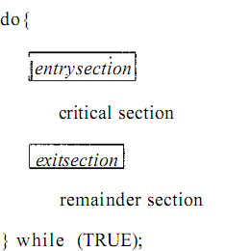
The Critical-Section Problem

Slide 12
The Critical-Section Problem
The solution to critical section problem must satisfy the following three requirements:
Mutual exclusion
Progress
Bounded Waiting
No assumption

Slide 13
Solutions to Critical Section Problem
Solutions to CS can be
Software solution
Hardware solution

Slide 14
Software-Based Solution
Peterson’s Solution
Peterson's solution is restricted to two processes that alternate execution between their critical sections and remainder sections. The processes are numbered P0 and P1.
Peterson's solution requires two data items to be shared between the two processes:
int turn;
boolean flag [2] ;

Slide 15
Software-Based Solution
int Flag[2]; int turn; Flag[0]=0 and Flag[1]=0 P1
do
{
Flag[0]=1; turn=1;
while(flag[1]=1 && turn==1)
{
do nothing
}
<critical section> Flag[0]=0;
<remainder section>
}
while(1);
P2
do
{
Flag[1]=1; turn=0;
while(flag[0]=1 &&turn==0)
{
do nothing
}
<critical section> Flag[1]=0;
<remainder section>
}
while(1);

Slide 16
Semaphores
It is a synchronization tool.
A semaphore S is an integer variable that, apart from initialization, is accessed only through two standard atomic operations: wait () and signal ().
Wait()- to test – also called P(proberen)semaphore
Signal()- to increment – also called V(verhogen) semaphore

Slide 17
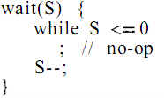

Semaphores
Definition for wait() and signal()

Slide 18
Usage
Binary Semaphores/Mutex
Counting semaphores

Slide 19
The Dining philosophers problem
“Five philosophers sit around a table, which is set with 5 plates (one for each philosopher), 5 chopsticks, and a bowl of rice. Each philosopher alternately thinks and eats. To eat, he needs the two chopsticks next to his plate. When finished eating, he puts the chopsticks back on the table, and continues thinking.”
Philosophers are processes, and chopsticks are resources.

Slide 20
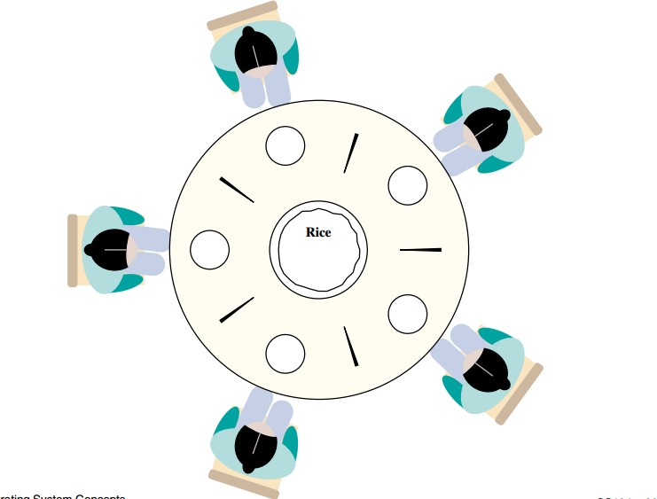
The Dining philosophers problem

Slide 21
The Dining philosophers problem
Methods:
start_eating(i): if chopsticks[i] < 2, then philosopher i must wait; otherwise decrement the chopstick counts, and eat
stop_eating(i): increments the neighboring chopstickscounts

Slide 22
void Philosopher
{
while(1)
{
take_fork[i]; take_fork[ (i+1) % 5] ; EATING THE NOODLE
put_fork[i]; put_fork[ (i+1) % 5] ;
THINKING
} }

Slide 23
Solution
One simple solution is to represent each chopstick with a semaphore.
A philosopher tries to grab a chopstick by executing a wait () operation on that semaphore; he releases his chopsticks by executing the signal() operation on the appropriate semaphores.

Slide 24
solution
void Philosopher
{
while(true)
{ wait( F[i] );
wait( F[ (i+1) % 5]);
// EATING THE NOODLE
signal( F[i] );
signal( F[ (i+1) % 5] ) ;
// THINKING
} }

Slide 25
Problem with this solution
We have proven that no two neighboring philosophers can eat at the same time using the above solution to the dining philosopher problem. The disadvantage of the above approach is that it may result in a deadlock situation. This occurs when all of the philosophers pick their left fork at the same time, resulting in a deadlock situation in which none of the philosophers can eat.

Slide 26
Solution to deadlock
the four beginning philosophers (P0, P1, P2, and P3) should choose the left Fork first, then the right Fork, while the philosopher (P4) should choose the right Fork first, then the left fork. This will force P4 to hold his right Fork first because P4's right Fork is F0, which is already held by philosopher P0 and whose value is set to 0, i.e., F0 is already 0, trapping P4 in an infinite loop and leaving Fork F4 unoccupied. As a result, because philosopher P3 has both a left F3 and a right F4 Fork, it will begin eating and then put down both Forks once finished, allowing others to eat, thereby resolving the deadlock problem.

Slide 27
Monitors
Another high-level synchronization construct is the monitor type. A monitor is characterized by a set of programmer-defined operators. The representation of a monitor type consists of declarations of variables whose values define the state of an instance of the type, as well as the bodies of procedures or functions that implement operations on the type. The syntax of a monitor is . The representation of a monitor type cannot be used directly by the various processes. Thus, a procedure defined within a monitor can access only those variables declared locally within the monitor and its formal parameters. Similarly, the local variables of a monitor can be accessed by only the local procedures. The monitor construct ensures that only one process at a time can be active within the monitor. Consequently, the programmer does not need to code this synchronization constraint explicitly. However, the monitor construct, as defined so far, is not sufficiently powerful for modeling some synchronization schemes. For this purpose, we need to define additional synchronization mechanisms. These mechanisms are provided by the condition operations construct. A programmer who needs to write her own tailor-made synchronization scheme can define one or more variables of type condition:

Slide 28
The only operations that can be invoked on a condition variable are wait and signal. The operation means that the process invoking this operation is suspended until another process invokes The x . signal (1 operation resumes exactly one suspended process. If no process is suspended, then the signal operation has no effect; that is, the state of x is as though the operation were never executed (Figure 7.21). Contrast this operation with the signal operation associated with semaphores, which always affects the state of the semaphore. Now suppose that, when the x. signal () operation is invoked by a process P, there is a suspended process Q associated with condition x. Clearly, if the operations suspended process Q is allowed to resume its execution, the signaling process P must wait. Otherwise, both P and Q will be active simultaneously within the monitor. Note, however, that both processes can conceptually continue with their execution. Two possibilities exist

Slide 29
1. P either waits until Q leaves the monitor, or waits for another condition.
2. Q either waits until P leaves the monitor, or waits for another condition. There are reasonable arguments in favor of adopting either option 1 or option 2. Since P was already executing in the monitor, choice 2 seems more reasonable. However, if we allow process P to continue, the "logical" condition for which Q was waiting may no longer hold by the time Q is resumed. Choice 1 was advocated by Hoare, mainly because the preceding argument in favor of it translates directly to simpler and more elegant proof rules. A compromise between these two choices was adopted in the language Concurrent C. When process P executes the signal operation, process Q is immediately resumed. This model is less powerful than Hoare's, because a process cannot signal more than once during a single procedure call

Slide 30
Monitor monitorName{ variables_declaration; condition_variables;
procedure p1{ ... };
procedure p2{ ... };
...
procedure pn{ ... };
{
initializing_code;
}
}

Slide 31
Characteristics of Monitors in OS
A monitor in os has the following characteristics:
We can only run one program at a time inside the monitor.
Monitors in an operating system are defined as a group of methods and
fields that are combined with a special type of package in the os.
A program cannot access the monitor's internal variable if it is running outside the monitor. Although, a program can call the monitor's functions.
Monitors were created to make synchronization problems less complicated.
Monitors provide a high level of synchronization between processes.

Slide 32
Components of Monitor in an operating system
The monitor is made up of four primary parts:
Initialization: The code for initialization is included in the package, and we just need it once when creating the monitors.
Private Data: It is a feature of the monitor in an operating system to make the data private. It holds all of the monitor's secret data, which includes private functions that may only be utilized within the monitor. As a result, private fields and functions are not visible outside of the monitor.
Monitor Procedure: Procedures or functions that can be invoked from outside of the monitor are known as monitor procedures.
Monitor Entry Queue: Another important component of the monitor is the Monitor Entry Queue. It contains all of the threads, which are commonly referred to as procedures only.

Slide 33
There are two sorts of operations we can perform on the
monitor's condition variables:
Wait
Signal
Consider a condition variable (y) is declared in the monitor:
y.wait(): The activity/process that applies the wait operation on a condition variable will be suspended, and the suspended process is located in the condition variable's block queue.
y.signal(): If an activity/process applies the signal action on the condition variable, then one of the blocked activity/processes in the monitor is given a chance to

Slide 34
Advantages of Monitor in OS
Monitors offer the benefit of making concurrent or parallel programming easier and less error-prone than semaphore-based solutions.
It helps in process synchronization in the operating system.
Monitors have built-in mutual exclusion.
Monitors are easier to set up than semaphores.
Monitors may be able to correct for the timing faults that semaphores cause.

Slide 35
Disadvantages of Monitor in OS
Monitors must be implemented with the programming language.
Monitor increases the compiler's workload.
The monitor requires to understand
what operating system features are available for controlling crucial sections in the parallel procedures.

